Slide 1
Software Engineering Principles

Slide 2
Anticipation of Change
Evolvability
Reusability
Open-Closed Principle (OCP)
See Chapter 3 of Ghezzi, Chapter 2 of Hamlet

Slide 3
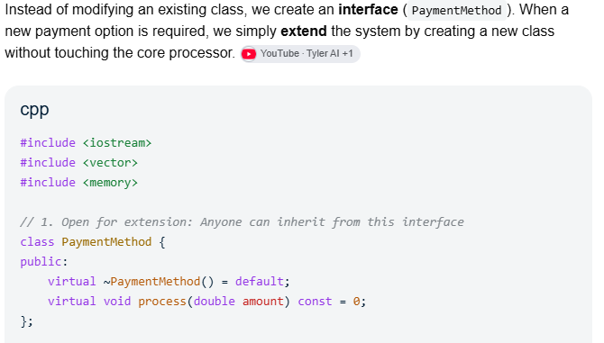
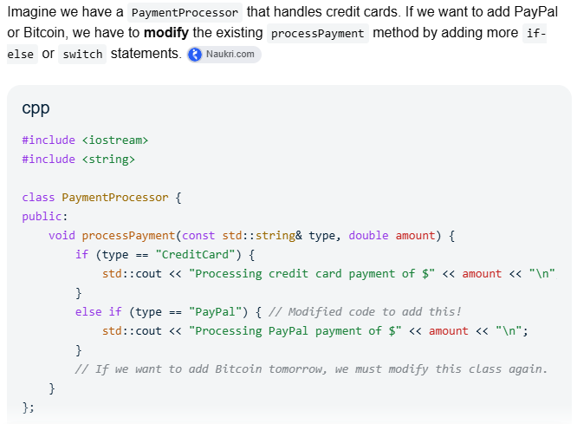
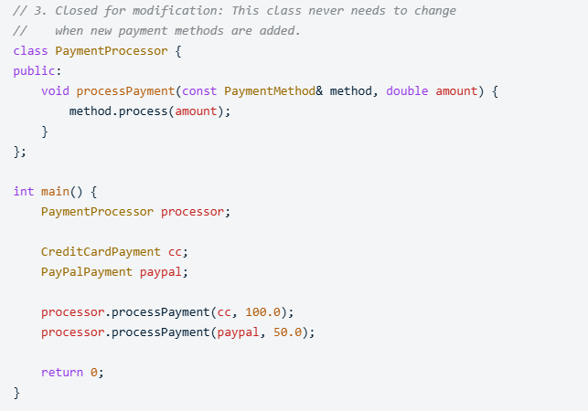
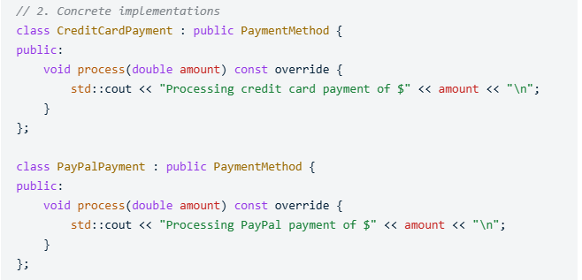
Anticipation of Change
Open-Closed Principle
Without anticipation of change in mind. OCP not followed.
With anticipation of change in mind. OCP compliant.
Code written by Gemini, use with caution.

Slide 4
Generality
The following four procedure interfaces are listed in order of increasing generality:
  PROCEDURE SUM: INTEGER;
  POSTCONDITION: returns sum of 3 global variables
  PROCEDURE SUM (a, b, c: INTEGER): INTEGER;
  POSTCONDITION: returns sum of parameters
  PROCEDURE SUM (a[]: INTEGER): INTEGER
  POSTCONDITION: returns sum of elements in array a
  Parameterizing context-specific information
Trade-offs?
See Chapter 3 of Ghezzi

Slide 5
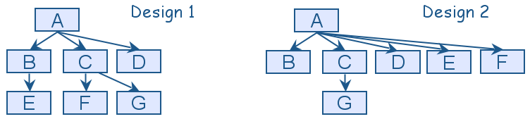
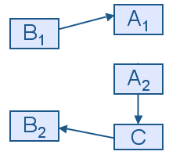
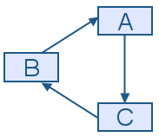
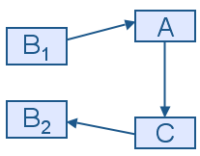
Incrementality
Increments
Early subsets
Early feedbacks
Prototypes
(a)
(b)
(c)
See Chapter 3 of Ghezzi

Slide 6
Abstraction
An abstraction is a model or representation that omits some details so that it can focus on other details
Suppose that one of the system functions is to sort the elements of a list L. The initial description of the design is:
  Sort L in non-decreasing order
  The next description may be a particular algorithm:
DO WHILE I is between 1 and (length of L)–1:
  Set LOW to index of smallest value in L(I),..., L(length of L)
Interchange L(I) and L(LOW)
ENDDO
The algorithm provides a great deal of additional information, however, it can be made even more detailed
See Chapter 3 of Ghezzi

Slide 7
Abstraction
The third and final algorithm describes exactly how the sorting operation will work:
DO WHILE I is between 1 and (length of L)-1
Set LOW to current value of I
DO WHILE J is between I+1 and (length of L)
IF L(LOW) is greater than L(J)
THEN set LOW to current value of J
ENDIF
ENDDO
Set TEMP to L(LOW)
Set L(LOW) to L(I)
Set L(I) to TEMP
ENDDO

Slide 8
Abstraction (Contd.)
10110100 00001001 10111010 00001100 00000001 11001101 00100001 10111000 00000000 01001100 11001101 00100001 01001000 01100101 01101100 01101100 01101111 00101100 00100000 01010111 01101111 01110010 01101100 01100100 00100001 00100100
.MODEL SMALL
.STACK 100H
.DATA
;Define the string variable. The '$' tells DOS where the string ends.
MSG DB 'Hello World!$’
.CODE
MAIN PROC ; Initialize the Data Segment (DS) register
MOV AX, @DATA
MOV DS, AX
; Load the address of the message and display it
LEA DX, MSG ; Load Effective Address of MSG into DX
MOV AH, 09H ; DOS function 09H to display a string
INT 21H ; Call DOS interrupt
; Terminate the program cleanly
MOV AH, 4CH ; DOS function 4CH to exit INT 21H ; Call DOS interrupt
MAIN ENDP
END MAIN
At every level
Code written by LLM, use with caution.

Slide 9
Identification of ‘Customers’
Customer of the software
A programmer is a customer of designer
A designer is a customer of requirements engineer
A test engineer is a customer of all other phases
A programmer is a customer of test engineer also
A user is a customer of maintenance phase
…
See Chapter 2 of Hamlet

Slide 10
Use of Consistent Terminology
Specification or Design?
Test has failed?
See Chapter 2 of Hamlet

Slide 11
Documentation
Record lest you forget it
Document assumptions at each stage
Traceability
Document structuring (placement of content)
Clarity
Repetition of terms vs definition of terms
Index
See Chapter 2 of Hamlet

Slide 12
Software as Transformation
Set of inputs to set of outputs
Identify all inputs and outputs
Identify the valid and invalid ranges of the I/O
Identify special or significant values of inputs and outputs
Identify important combinations of the input output values
See Chapter 2 of Hamlet

Slide 13
Software as Transformation (Example)
Consider an online telephone directory that is being developed to replace the phonebook that is provided by your phone company. The online directory should be able to provide phone numbers when presented with a name; it should also list area codes for different parts of the country and generate emergency telephone numbers for your area on request.

Slide 14
Reuse
Know the existing libraries
Develop the software so that it can be reused
  Requirements
  Code
    E.g. well specified function prototypes (aka interfaces)
See Chapter 2 of Hamlet

Slide 15
References
SE book by Ghezzi
SE book by Hamlet
SE book by Pfleeger
SE book by Pressman
https://www.educative.io/edpresso/what-are-the-different-types-of-coupling

